Slide 1


ENGINEERING CAPSTONE PROJECT – 1/INDUSTRIAL INTERNSHIP/ INDUSTRIAL INTERNSHIP PHASE-I
Project Review-2
Enterprise Role-Based Access Control (RBAC) & Identity Auditor
Team No-16
Roll No | Name
2320030047 | P.Varun Reddy
2320030410 | K.Chandana
2320030446 | Pardhava Nandan
Under the Guidance of
Dr. K. Swanthana
Assistant Professor
Department of Computer Science and Engineering
KONERU LAKSHMAIAH EDUCATION FOUNDATION

Slide 2
OUTLINE
Methodology
System Design and Architecture
Modern Tools and Technologies
Implementation
Implemented Functionality
Experimental Setup
Results

Slide 3
Methodology
Requirement Analysis – Identify users, roles, permissions, and security needs.
RBAC Design – Define User–Role–Permission relationships.
Authentication & Authorization – Secure login and access control using Spring Security.
Identity Auditing – Record user activities and access events.
Privilege-Creep Detection – Identify excessive or unused privileges.
Risk Analysis – Identify high-risk accounts and access.
Reporting – Generate security and compliance reports.
Testing – Test all security and system functions.
Flow:
User → Authentication → RBAC → Audit → Risk Analysis → Report

Slide 4
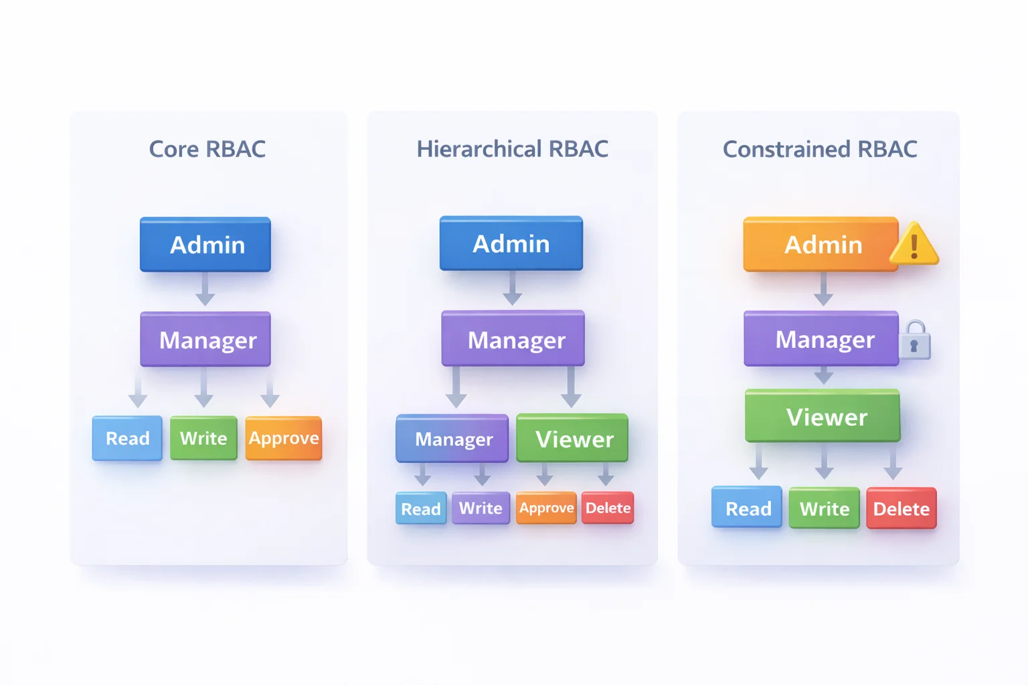
System Design and Architecture

Slide 5
Risk Assessment Model
Context Factor | Condition | Risk Contribution
User Privilege | Admin / Elevated privilege | +25
Excessive Permissions | More permissions than required | +25
Unused Privilege | Unused for 30+ days | +20
IP Address | Unknown IP | +5
Device | Unknown device | +20
Login Time | 11 PM–6 AM | +15
Failed Attempts | 1 | +5
Session Activity | Suspicious | +25
Unauthorized Access | Access denied repeatedly | +30
Role Assignment | Incorrect/high-risk role | +25

Slide 6
Risk Classification
Risk Level | Risk Score | Classification Criteria | Recommended Action
Low | 0–20 | Normal access and no major security issues | Monitor
Medium | 21–40 | Unused privileges or minor suspicious activity | Review permissions
High | 41–60 | Excessive privileges, repeated failed attempts, or suspicious access | Immediate review
Critical | 61+ | Highly privileged account with multiple security risks | Immediate investigation and access restriction

Slide 7
Modern Tools and Technologies
Frontend
Category | Technology / Tool | Purpose
Programming Language | Java | Backend development
Framework | Spring Boot | Build backend application and REST APIs
Security | Spring Security | Authentication and authorization
Authentication | JWT | Secure user authentication
Password Security | BCrypt | Secure password hashing
Database | MySQL | Store users, roles, permissions, and audit logs
ORM | Spring Data JPA / Hibernate | Database operations
API | REST API | Communication with frontend
Auditing | Spring AOP | Track user and system activities
Risk Analysis | Java | Calculate user access risk
Report Generation | OpenCSV / PDF Library | Generate security reports
API Testing | Postman | Test backend APIs
API Documentation | Swagger / OpenAPI | Document and test APIs
Build Tool | Maven | Manage dependencies and build project
Development Tool | IntelliJ IDEA / VS Code | Backend development
Version Control | Git & GitHub | Source-code management

Slide 8
Modern Tools and Technologies
Backend
Category | Tool / Technology | Purpose in the Project
Programming Language | Java | Develop backend logic
Backend Framework | Spring Boot | Build the backend application and REST APIs
Security Framework | Spring Security | Authentication and authorization
Authentication | JWT | Secure user authentication and sessions
Password Security | BCrypt | Securely hash user passwords
RBAC | Spring Security RBAC | Manage roles and permissions
Database | MySQL | Store users, roles, permissions and audit records
ORM | Spring Data JPA / Hibernate | Connect Java application with MySQL
Auditing | Spring AOP | Monitor and record user activities
Risk Assessment | Java-based Risk Engine | Identify high-risk and over-privileged accounts
Privilege-Creep Detection | Java Scheduler | Detect unused privileges over a defined period
API | REST API | Connect frontend with backend
API Testing | Postman | Test authentication and security APIs
API Documentation | Swagger / OpenAPI | Document backend APIs
Build Tool | Maven | Manage dependencies and build the application
IDE | IntelliJ IDEA / VS Code | Backend development
Version Control | Git & GitHub | Manage source code

Slide 9
Implementation
Core Modules:
Component | Responsibility
AuthController | Handles registration and login APIs
UserService | Manages users and authentication
RoleService | Manages roles and role assignments
PermissionService | Manages permissions and access rights
RBACService | Handles role-based access control
AuditLogService | Records user and security activities
PrivilegeAuditService | Detects excessive and unused privileges
RiskAssessmentService | Calculates user access risk
AccessControlService | Validates user permissions
ReportService | Generates security and compliance reports

Slide 10
Implemented Functionality
Current Functional Features
User registration
Secure password hashing using BCrypt
Secure user login
User and account management
Role creation and assignment
Permission management
Role-Based Access Control (RBAC)
User–Role–Permission mapping
Privileged account monitoring
Privilege-creep detection
Least-privilege access monitoring
Identity and access auditing
Security event logging
Risk assessment and classification
ALLOW / DENY access decisions

Slide 11
Experimental Setup
1. Development Environment
Operating System: Windows 10/11
Programming Language: Java
Backend: Spring Boot
Security: Spring Security + JWT
Frontend: React.js
Database: MySQL
ORM: Spring Data JPA / Hibernate
2. Testing Setup
. User registration and login testing
. Role and permission assignment testing
. RBAC authorization testing
. Unauthorized-access testing
. Privilege-creep detection testing
. Identity-audit and security-log testing

Slide 12
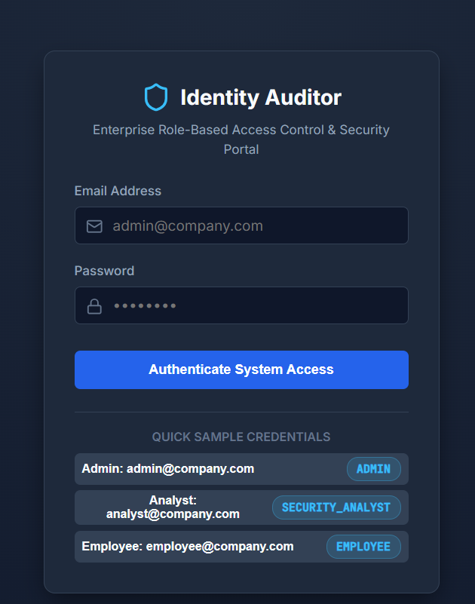
Results

Slide 13
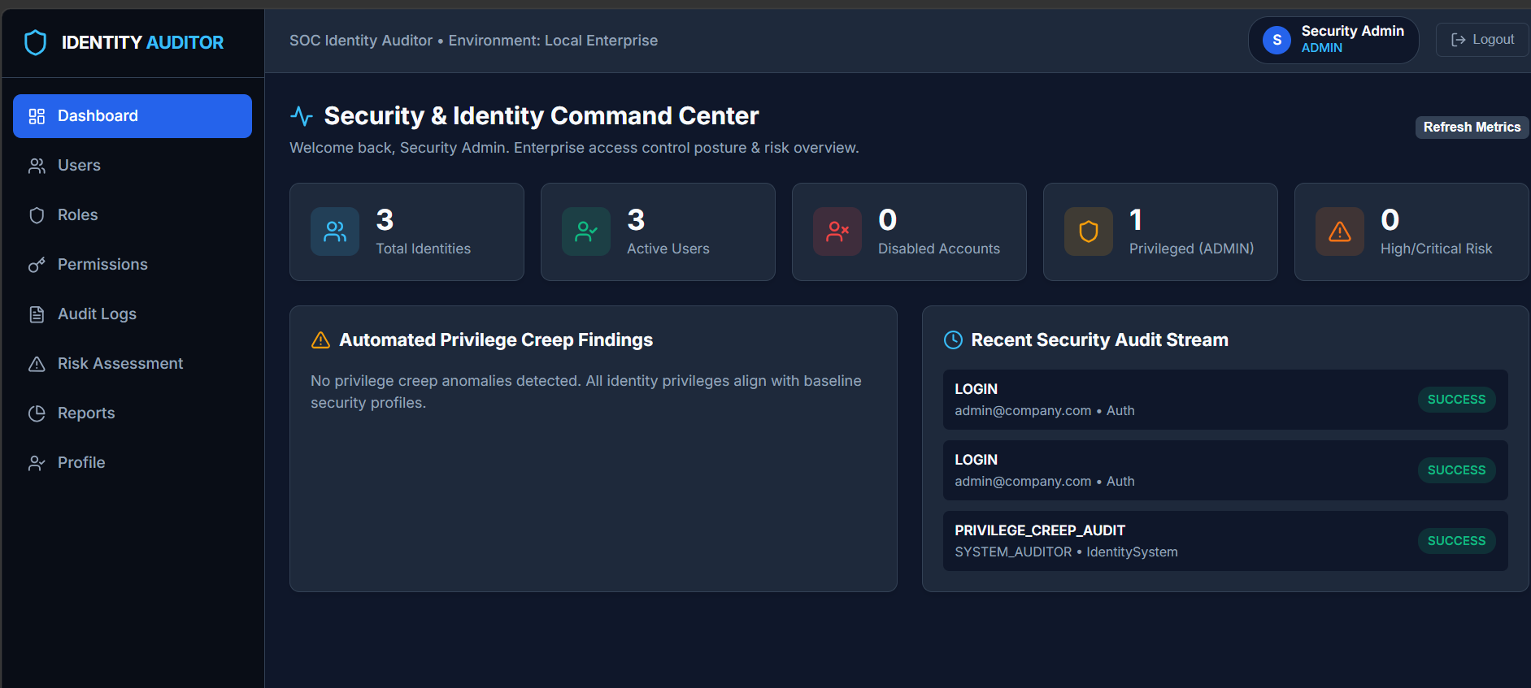

Slide 14
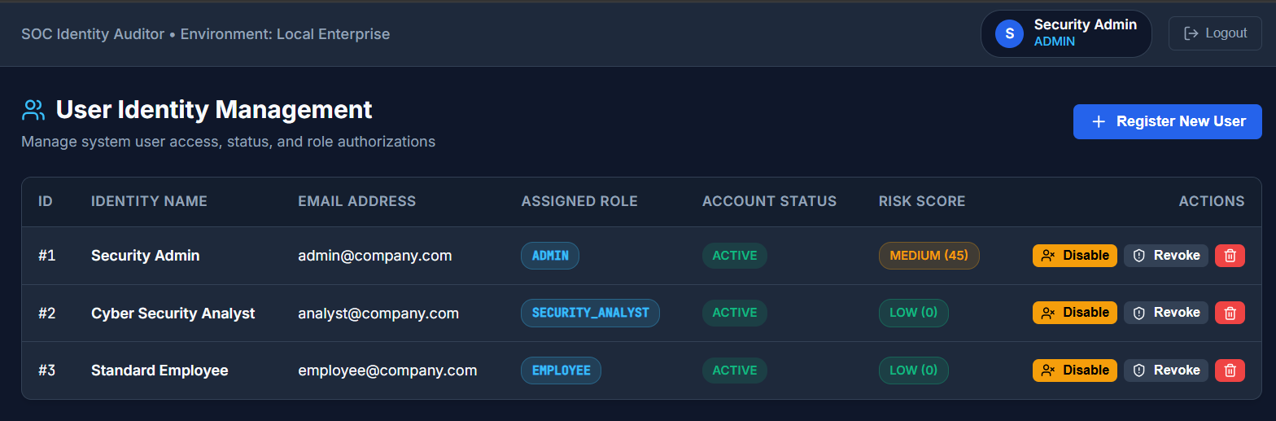
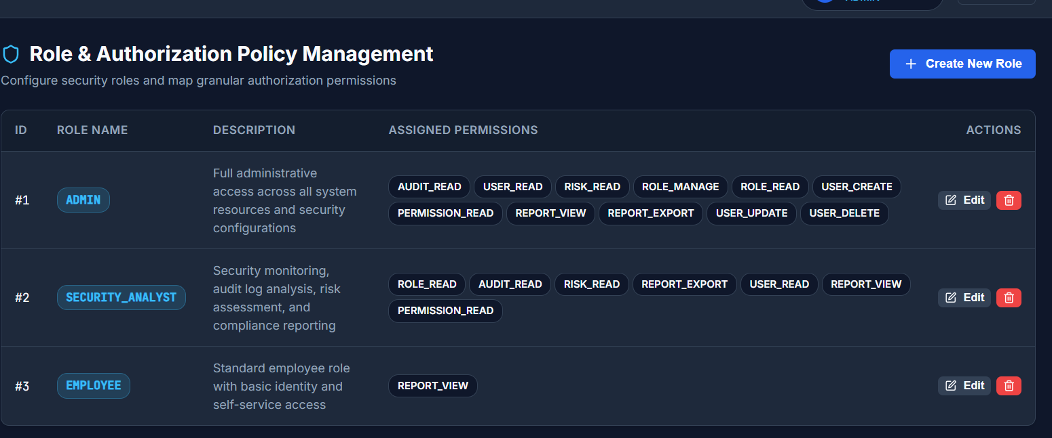

Slide 15
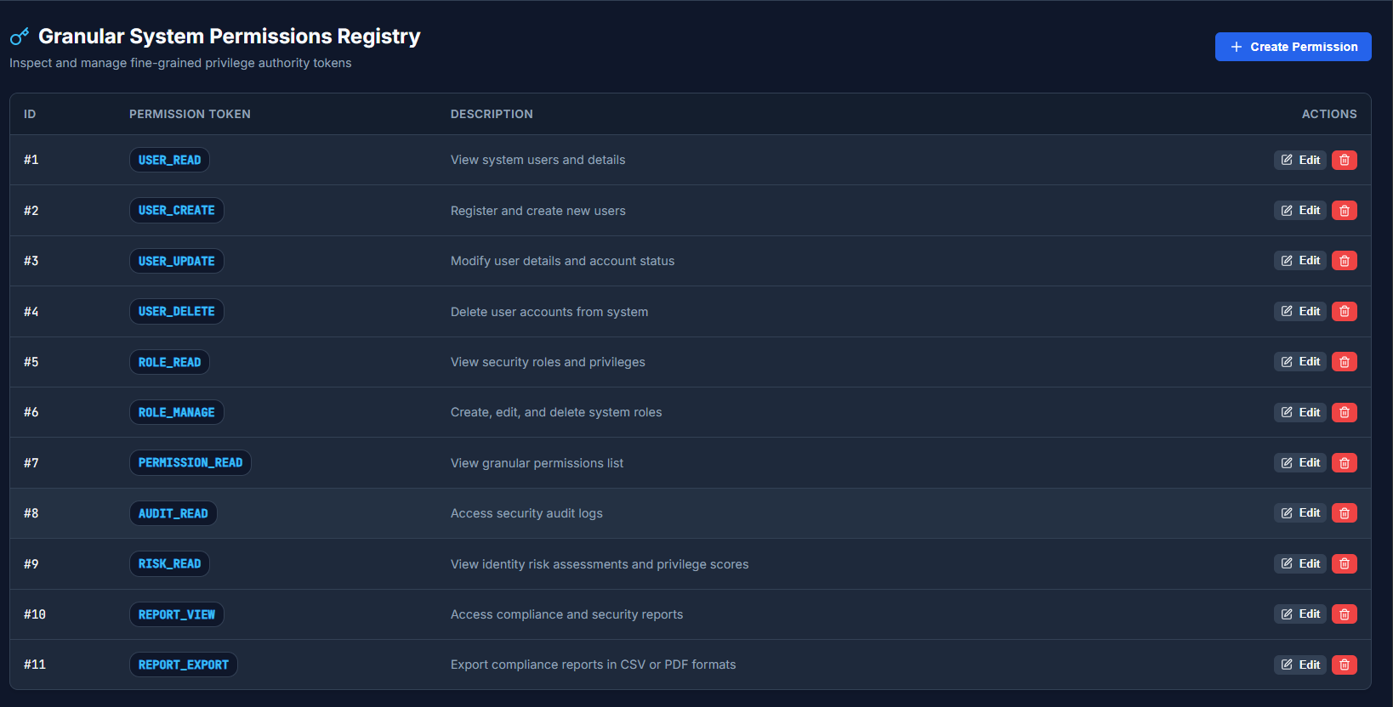

Slide 16
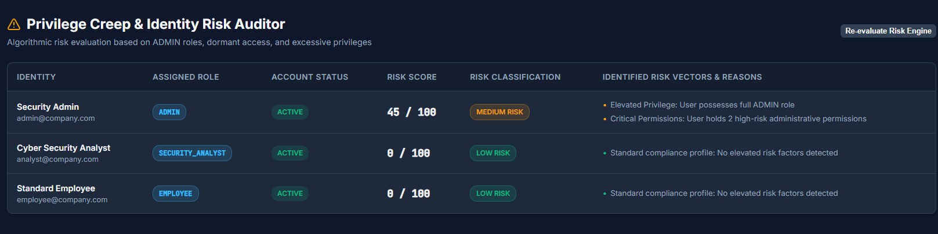

Slide 17
THANK YOU

